Slide 1
Understanding People: Personality, Values & Abilities

Slide 2
Personality and Values
What is personality? What is value? What is ability?
Textbook: Chapter 5
  Personality types (Myers-Brigg, Big 5, etc.)
  Values (terminal versus instrumental)
Lecture
  Understand some personality types
  Understand utility and limitations of using personality to help management
  For managers, is it important to understand oneself and others?

Slide 3
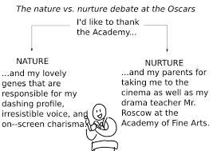
Personality Determinants

Slide 4
Personality Determinants
Nature: Heredity
  Factors determined at conception: physical stature, facial attractiveness, gender, temperament, muscle composition and reflexes, energy level, and bio-rhythms
  This “Heredity Approach” argues that genes are the source of personality
  Twin studies: raised apart but very similar personalities
Nurture: Environment
  There is some personality change over long time periods

Slide 5
Two dominant frameworks used to describe personality:
Myers-Briggs Type Indicator (MBTI®)
Big Five Model

Slide 6
What Personality?
Myers-Briggs Type Indicator (MBTI)
  Extraverted versus introverted (E or I): outgoing, sociable, assertive versus quiet, shy
  Sensing versus intuitive (S or N): practical, prefer routine and order, detailed versus looking at big picture, unconscious processes
  Thinking versus feeling (T or F): reason and logic versus values and emotions
  Judging versus perceiving (J or P): control, structure versus flexible, spontaneous
  16 types

Slide 7
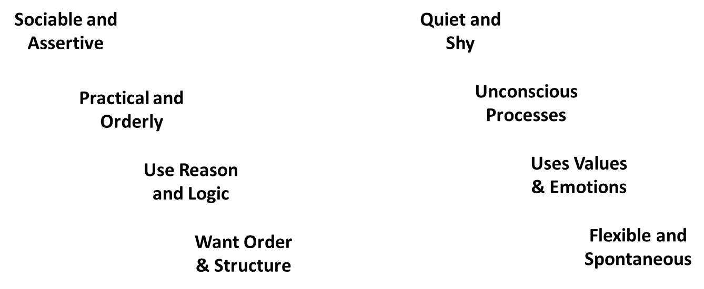
The Myers-Briggs Type Indicator
Extroverted (E)
Introverted (I)
Sensing (S)
Intuitive (N)
Thinking (T)
Feeling (F)
Judging (J)
Perceiving (P)

Slide 8
Sample items
Are you usually
  A. a "good mixer", or [E]
  B. rather quiet and reserved? [I]
If you were a teacher, would you rather teach
  A. fact courses, or [S]
  B. courses involving theory? [N]

Slide 9
Sample items
Which word in the pair below appeals to you more ?
  A. Analyze [T]
  B. Sympathize [F]
When you go somewhere for the day, would you rather
  A. plan what you will do and when, or [J]
  B. just go? [P]

Slide 10
Discussion
Identify the MBTI category of the following types of personality.
Note that there are 16 possible categories.
  Visionaries – original, stubborn, and driven
  Organizers – realistic, logical, analytical, and businesslike
  Conceptualizer – entrepreneurial, innovative, individualistic, and resourceful
What jobs do you think people with these categories would be best for?
Do you think MBTI can help match people to jobs? Why?

Slide 11
MBTI
Each of the sixteen possible combinations has a name, for instance:
  Visionaries (INTJ) – original, stubborn, and driven
  Organizers (ESTJ) – realistic, logical, analytical, and businesslike
  Conceptualizer (ENTP) – entrepreneurial, innovative, individualistic, and resourceful

Slide 12
Myers-Briggs Type Indicator (MBTI)
Research results on validity mixed
It matters in some cases:
  Most widely used in organizations: Apple, AT&T, Citigroup, GE, 3M
  Some types are powerful
    13 contemporary business people who created super-successful organizations (Apple, FedEx, Honda, Microsoft, Sony)
    All NTs [intuitive, thinking], only 5% of population
  MBTI® is a good tool for self-awareness and counseling.
Debatable whether should be used as a selection test for job candidates.

Slide 13
The Big Five Model of Personality Dimensions
Extroversion
Sociable, gregarious, and assertive
Agreeableness
Good-natured, cooperative, and trusting
Conscientiousness
Emotional Stability
Openness to Experience
Responsible, dependable, persistent, and organized
Calm, self-confident, secure under stress (positive), versus nervous, depressed, and insecure under stress (negative)
Curious, imaginative, artistic, and sensitive
Notes:
The Big Five model of personality sets forth that there are five basic dimensions that underlie all others and encompass most of the significant variations in human personalities. The Big Five factors are: Extroversion, Agreeableness, Conscientiousness, Emotional Stability and Openness to Experience. There is a lot of research that supports the Big Five model and it has been shown to predict behavior at work.

Slide 14
Big Five
Extraversion: sociable, gregarious, assertive
Agreeableness: good natured, cooperative, trusting
Conscientiousness: responsible, dependable, persistent, organized
Emotional stability: calm, self-confident, secure, positive
Openness to experience: imagination, sensitivity, curiosity

Slide 15
Sample items
Extraversion
  I really like most people I meet
Agreeableness
  I believe that most people are basically well-intentioned
Conscientiousness
  I keep myself informed and usually make intelligent decisions
Emotional stability
  I am not a worrier
Openness
  I have a very active imagination

Slide 16
How Do the Big Five Traits Predict Behavior?
Research has shown this to be a better framework.
Certain traits have been shown to strongly relate to higher job performance:
  Highly conscientious people develop more job knowledge, exert greater effort, and have better performance.
Indra Nooyi, CEO and Chair, PepsiCo
  Sociable, agreeable, conscientious, emotionally stable, open to experiences
Notes:
There are certain traits that have been shown by extensive research to be strongly related to higher job performance. Conscientiousness has been shown as an effective predictor of better performance based on more extensive job knowledge and the willingness to exert greater effort.
In addition, the other five traits have implications for work. Emotional stability is related to job satisfaction and agreeable people are better in social-related jobs such as sales and customer service.

Slide 17
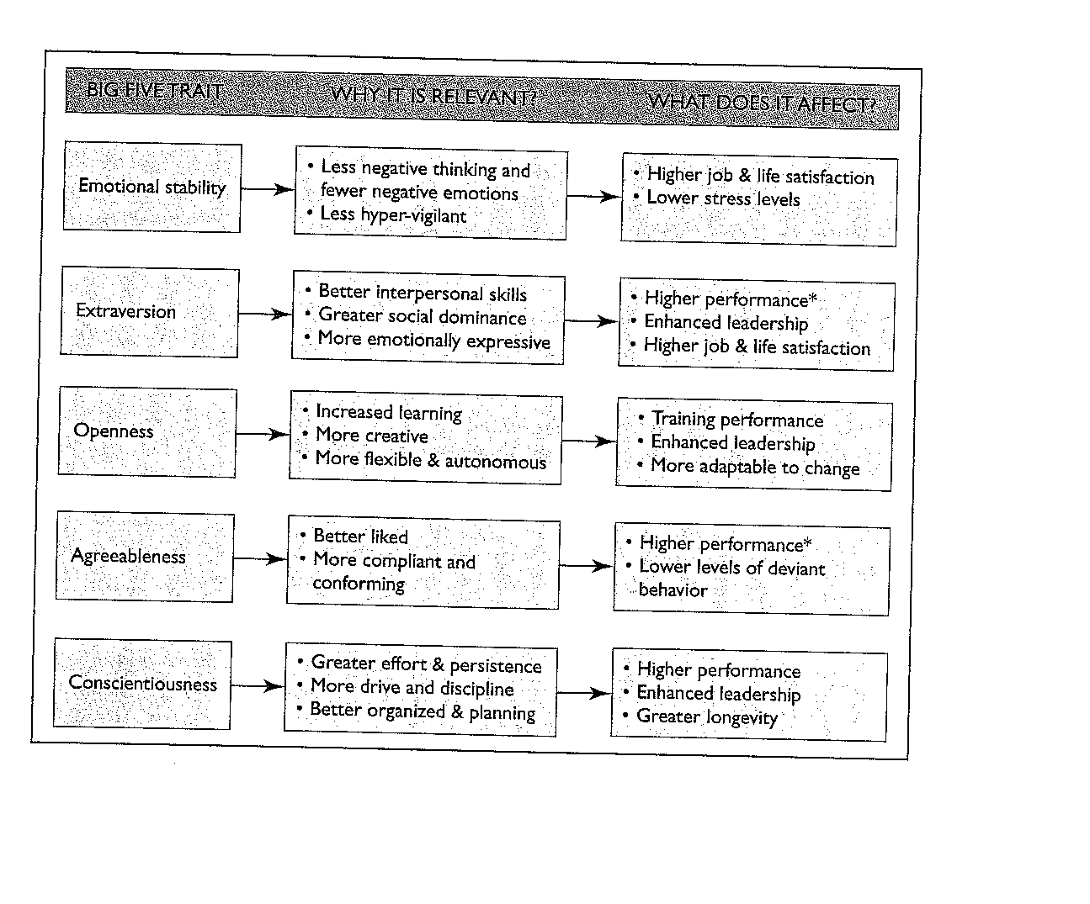
Big 5: It has implications

Slide 18
Limitations
Do personality, values and skills predict behaviors?
Theories
  Most theories of personality and values are developed to capture as many people with as few categories as possible
Practice
  Response constrains
There will always be individual differences

Slide 19
Values
Basic convictions on how to conduct yourself or how to live your life that is personally or socially preferable – “How To” live life properly.
Notes:
Values represent basic convictions that make judgments about what is the best mode of conduct or end-state of existence. There are two attributes of values. There is a content component that looks at the level of importance of the mode of conduct or end-state and the intensity component that looks at how important that content is.
A person’s value system ranks values by their intensity. This tends to be relatively constant over time.

Slide 20
Importance of Values
Provide understanding of the attitudes, motivation, and behaviors
Influence our perception of the world around us
Represent interpretations of “right” and “wrong”
Imply that some behaviors or outcomes are preferred over others
Notes:
Values are very important because they provide an understanding of attitudes, motivation, and behaviors. Values play a role in how we perceive the world around us and how we interpret right and wrong. Values imply that some behaviors are preferred over others based on how/what we value.

Slide 21
Classifying Values – Rokeach Value Survey
Terminal Values
  Desirable end-states of existence; the goals that a person would like to achieve during his or her lifetime
Instrumental Values
  Preferable modes of behavior or means of achieving one’s terminal values
People in same occupations or categories tend to hold similar values
  But values vary between groups
  Value differences make it difficult for groups to negotiate and may create conflict
Notes:
The Rokeach Value Survey was created by Milton Rokeach. It consists of two sets of values, terminal values and instrumental values. Terminal values describe the desired values/goals a person would like to keep/achieve through their lifetime. Instrumental values are the preferred modes of behavior or means of achieving one’s terminal values.
Values vary between groups and can cause trouble when group members hold different values and negotiation is needed.

Slide 22
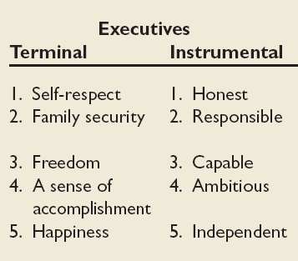
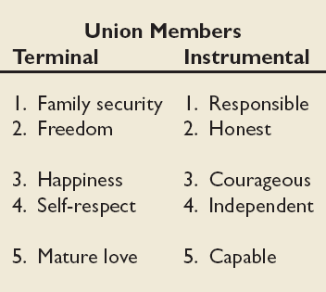
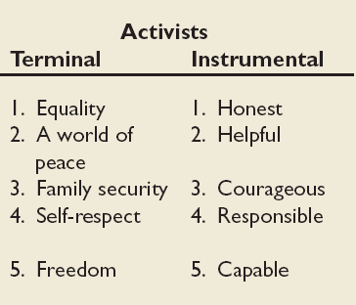
Value Differences Between Groups
Source: Based on W. C. Frederick and J. Weber, “The Values of Corporate Managers and Their Critics: An Empirical Description and Normative Implications,” in W. C. Frederick and L. E. Preston (eds.) Business Ethics: Research Issues and Empirical Studies (Greenwich, CT: JAI Press, 1990), pp. 123–44.
Notes:
This table shows some differences between different employment groups as there are often similarities between job categories.

Slide 23
Generational Values
Cohort | Entered Workforce | Approximate Current Age | Dominant Work Values
Veterans | 1950-1964 | 65+ | Hard working, conservative, conforming; loyalty to the organization
Boomers | 1965-1985 | 40-60s | Success, achievement, ambition, dislike of authority; loyalty to career
Xers | 1985-2000 | 20-40s | Work/life balance, team-oriented, dislike of rules; loyalty to relationships
Nexters | 2000-Present | Under 30 | Confident, financial success, self-reliant but team-oriented; loyalty to both self and relationships
Notes:
The workplace is made up of a number different generations of workers, more so than ever before seen in history. These workers bring with them different sets of values and corresponding work behaviors. For example, veterans tend to be conservative and conform to standards whereas nexters tend to be self-reliant but still team oriented.

Slide 24
Summary and Managerial Implications
Personality
  Screen for the Big Five trait of conscientiousness
  Take into account the situational factors as well
  MBTI® can help with training and development
Values
  Often explain attitudes, behaviors, and perceptions
  Higher performance and satisfaction achieved when the individual’s values match those of the organization
Notes:
Personality and values are very important to the workplace and play a solid role in predicting behavior. There are some good frameworks and models that can aid us in applying these theories and assist managers in being better predictors of workplace behavior.

