Slide 1
Data-Driven Learning of Q-Matrix
Jingchen Liu, Geongjun Xu and Zhiliang Ying (2012)

Slide 2
Model Setup and Notation
Participant-specific
Response to items: R = (R¹, … , R^{J})^{T}
Attribute profile: α = (α₁, … , α_{K})^{T}
Q-matrix: a J×K matrix specifies the item-attribute relationship
ideal response (latent variable):
Item-specific
slipping and guessing parameters
Response function

Slide 3
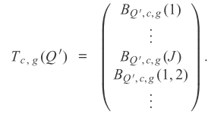
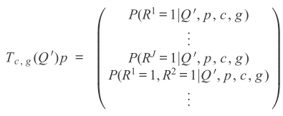
Estimation of the Q-Matrix
Intuition
T-matrix: connection between the observed response distribution and the model structure.
B-vectors:
as as N → ∞.
1*2^{K} 2^{K}*1

Slide 4
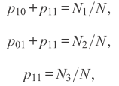
Example
With a correctly specified Q-matrix:
(0,0)
(0,1)
(1,0)
(1,1)
(0,0)
(1,0)
(1,0)
(1,1)

Slide 5
Objective function and estimation of the Q-matrix
→
Dealing with the unknown parameters
→
→
Remark1: a T-matrix including at least up to (K+1)-way combinations performs well empirically (Liu, Xu, and Ying, 2011).

Slide 6
Computations
Algorithm 1
Starting point Q(0) = Q₀
step 1:
step 2:
step 3:
Repeat Steps 1 to 3 until Q(m) = Q(m-1)
Total computation per iteration = J×2^{K}
Remark 2: if Q₀ is different from Q by 3 items (out of 20 items) Algorithm 1 has a very high chance of recovering the true matrix with reasonably large samples.

Slide 7
Simualtion
Estimation of the Q-Matrix With No Special Structure

Slide 8
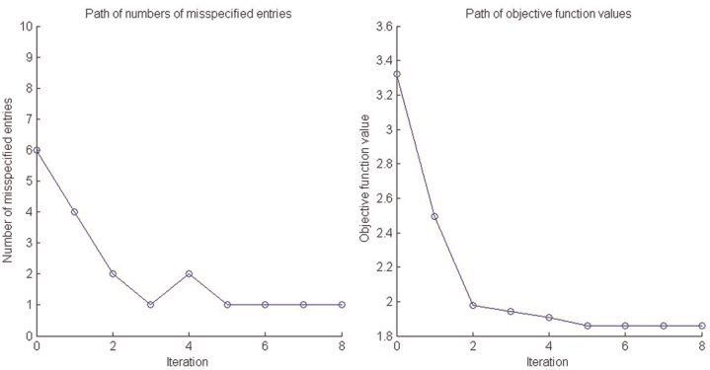
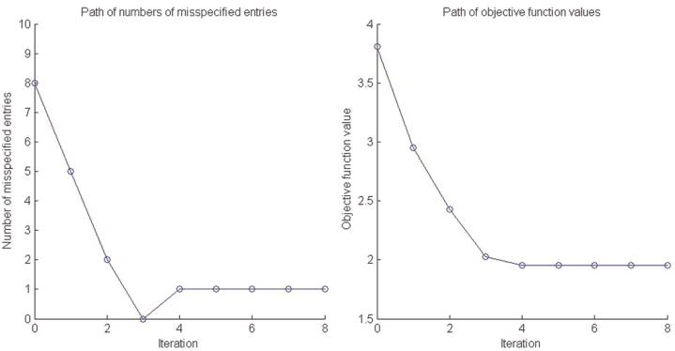
An improved estimation procedure for small samples

Slide 9
When attribute profile α follows a nonuniform distribution

Slide 10
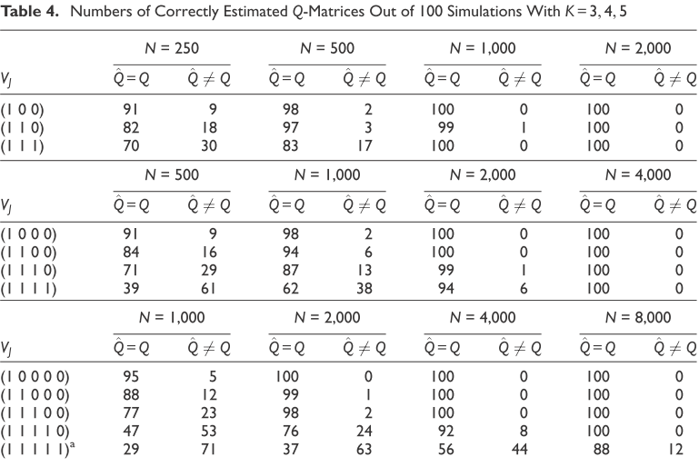
Estimation of the Q-Matrix With Partial Information

Slide 11
Discussion
Estimation of the Q-matrix for other DCMs
Incorporating available information in the estimation procedure
Theoretical properties of the estimator
Model valuation
Sample size
Computation

Slide 12
Comments & Qustions
The scoring matrix in IRT has a similar nature with the Q-matrix in CDMs. Accordingly we may apply the algorithm to explore the dimensionality of items in IRT.
A question is especially concerned by laymen that, if the estimated Q-matrix does not match the one specified by a group of experts, which one should we select?
What is the maximum number of missing items in the Q-matrix?
The algorithm is similar to iteration procedure in DIF study. I’m thinking the consequence of implement purification procedure to obtain correct Q-matrix?
How to calibrate a newly added item to the tests in which a subset of items whose attributes are known?

