Slide 1
A Multicomponent Latent Trait Model for Diagnosis
Susan E. Embretson
Xiangdong Yang

Slide 2
Component
Translates between the numerical, tabular, graphical and symbolic representation of linear relationships with integer coefficients and constants.
Items in Table 2.
Components can be set as:
1. Number/Computation; 2. Algebra; 3. Geometry; 4. Data
Can also be set as (Processing stages):
1. Translation; 2. Integration; 3. Solution Planning; 4. Solution Execution;
5. Decision Processing.
Computational burden, and procedural complexity

Slide 3
Model Review
Classification
CDMs
LCDM-
dichotomous
GDM-
Dichotomous/
Polytomous
Latent Trait
LLTM
MIRT-
MLTM (1980)
GLTM (1984)

Slide 4
MLTM
Multicomponent latent trait models (1980)
To reproduce test performances from both person and item parameters on the underlying information processes.

Slide 5
GLTM
General latent trait model (1984)
Combine LLTM (Fischer, 1973) and MLTM.
Both models were developed to link item responses to the theoretical variables that influence performances.

Slide 6
MLTM-D
C-matrix: Relation between items and components
Q-matrix : Relation between components and attributes.

Slide 7
Simulation– parameter recovery
Person: 1000, , correlation (0.3, 0.4, 0.5)
Item: 60, up to 3 components, 6 blocks, difficulty ~ N(-1, 1)
Attribute: 2
Variance of erorr: 0/ 0.10

Slide 8
Application
High-stakes test of mathematics achievement
3000 8th-grade students
4 standards (Number/Computation; Algebra; Geometry; Data Analysis)
25 indicators
86 multiple choice items.
Three models:
Full component model
Restricted hierarchical model
Null model

Slide 9
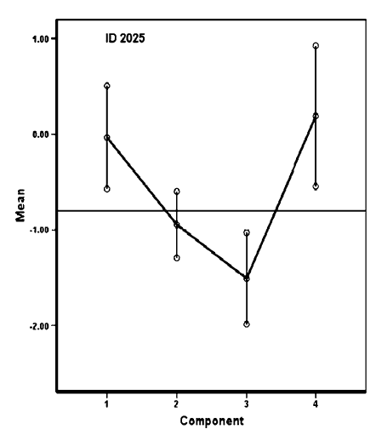
Diagnosis

Slide 10
Compare with CDMs
1. Number of parameters to be estimated.
2. Conceptualization about the nature of competency.
3. Type of test for which the model are most appropriate.
CDMs – short test, homogeneous items.
MLTM-D – long test, heterogeneous
items, various skills,
hierarchical structure.

Slide 11
Models for diagnosis
Confirmatory models.
Theoretical background.

