Slide 1



Rasch trees: A new method for detecting differential item functioning in the Rasch model
Carolin Strobl
Julia Kopf
Achim Zeileis

Slide 2
Introduction to DIF
Most DIF methods are based on the comparison of the item parameter estimates between two or more pre-specified groups.
  Can be interpreted straightforwardly
  Cannot rule out the influence from factors that are not pre-identified in analyses.
The latent class (or mixture) approach (Rost, 1990)
  No straightforward interpretation of the resulting groups.

Slide 3
A new method
Recursively test all groups that can be defined according to (combinations of) the available covariate.
Model-based recursive partitioning
  Related to classification and regression trees (CART)
    makes no assumption about a data-generating function
    Recursively partitions observations into increasingly smaller subgroups, whose members are increasingly similar in the outcome variable.
    Data-driven, exploratory approach
Notes:
Select the variable and splitting point that separate the observations into subsets for which the distributions of the outcome variable are most different.
Produces binary splits only.

Slide 4
Steps
  One joint Rasch model is fit for all subjects.
  It is tested statistically whether the item parameters differ along any of the covariates.
  Select the splitting variable and the optimal cutpoint that could achieve the maximum partitioned log-likelihood.
  Split the sample according to step 3’s suggestion.
  Repeat steps 1-4 until a stopping criterion is reached.
Notes:
1-1Use conditional maximum likelihood approach and can be adapted to other MLE.
1-2 Constrain the first item parameter or the sum of all item parameters to zero.

Slide 5
Step 1:
Estimate item parameters
Use the conditional maximum likelihood

Slide 6
Step 2: Examine parameter instability to split samples
Individual contributions to the score function:
Notes:
If a joint parameter estimate is appropriate for the entire sample, the score contributions ordered according to the variable of age won’t fluctuate randomly around the mean of zero.

Slide 7
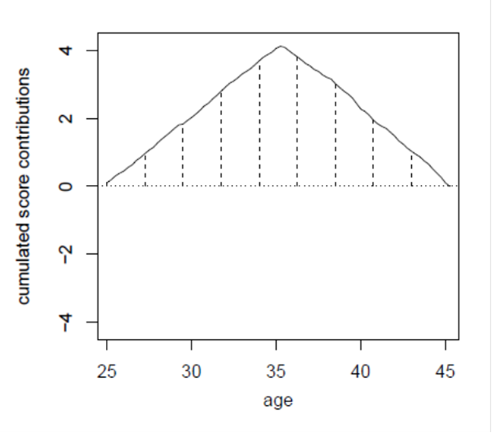
Notes:
If a joint parameter estimate is appropriate for the entire sample, the score contributions ordered according to the variable of age won’t fluctuate randomly around the mean of zero.

Slide 8
Examine structural change
  Use the generalized M-fluctuation tests
  For numeric covariates
  For categorical covariates
Notes:
If a joint parameter estimate is appropriate for the entire sample, the score contributions ordered according to the variable of age won’t fluctuate randomly around the mean of zero.
歐幾里得範數

Slide 9
Step 3: Select the cutpoint
The partitioned log-likelihood:
This formulate does not describe how the proposed method examine more than one cutpoints in a single test.

Slide 10
Computations
In step 2, score test (or termed as Lagrange multiplier test) is used.
  More efficient
In step 3, the likelihood ratio test is used.
  Using different random samples from the same data might yield different values for the optimal cutpoint.
Advantages of the two-step approach
  More efficient
  Avoid variable selection bias

Slide 11
Stopping criteria
Stop when no significant instability with any covariates.
  p =.05
Stop when sample sizes per node reach the pre-specified minimal node-size.
Bonferroni adjustment on the p value

Slide 12
Simulation study
Compare the Rasch tree with LR
Criterion
  Type I error rate and power
  Root mean squared error (RMSE) of parameter estimation
  Adjusted Rand index (ARI): the agreement between the true and the recovered partition.
  Bias, variance and mean squared error (MSE) of cutpoint estimation.
  Computation time.

Slide 13
General settings
5000 replications for each condition
20 items
The overall sample size was 500.

Slide 14
Simulation study 1
Settings
  For the LR test, numeric covariates are split at the median to define the reference and the focus groups.
  DIF size =1.5
  Only one covariate (either binary or numeric)
  Cutpoint location for the numeric covariate is median or 80.

Slide 15
Simulation study 1: Results

Slide 16
Simulation study 1: Results (Cont.)

Slide 17
Simulation study 1: Results (Cont.)

Slide 18
Simulation study 2
Settings
  DIF size =1.5
  Only one binary covariate
  Ability difference: -0.5 and +0.5

Slide 19
Simulation study 2: Results

Slide 20
Simulation study 2: Results (cont.)

Slide 21
Simulation study 3
Settings
  DIF size =1.5
  DIF patterns
    Binary
    U-shaped: young and old subjects vs. middle-aged subjects.
    Interaction between two covariates
  Cutpoint locations at the medium or 80.
  For LR test, two levels of the binary covariate or two groups using a median; and Bonferroni adjustment is used.

Slide 22
Simulation study 3 (Cont.)
Power
  For LR test: the percentage of replications in which a test for DIF for the two pre-specified groups is sig.
  For Rasch tree: the percentage of replications in which at least one split is made by the tree.

Slide 23
Simulation study 3: Results

Slide 24
Simulation study 3: Results (cont.)
These should not be called power because a wrong covariate is used.

Slide 25
An empirical example
An online quiz of general knowledge
  1056 university students enrolled in the federal state of Bavaria
  History with 9 items
Use gender and age as covariates

Slide 26
It will be more clear if the figures of different nodes are combined in one figure using different lines to indicate the item difficulty estimates.

Slide 27
General comments from Prof. Wang
Should look for methods to make a model identified, not using equal mean difficulty.
If only an interaction exists and no main effects from grouping members, can this model detect DIF items?
When more DIF items are in data, analyses on the residuals will be biased and this approach might not be able effectively detect DIF items.

Slide 28
Comments
Might not be applicable to long test due to the use of conditional ML.
Bonferroni adjustment should be always used in Rasch tree.
This model didn't detect the DIF bias in individual item, and it should be called DTF.
Why is the minimal node-size set at 20?
Mixture approach finds covariates/ groups during estimation. Thus, it might outperform than the proposed approach when the membership was unobserved.

Slide 29
Future studies
Extend its use to other models:
  the partial credit model
  2PL, and 3PL models.
The extension to multiway splits?
  O’Brien SM (2004). “Cutpoint Selection for Categorizing a Continuous Predictor.” Biometrics, 60, 504–509.
Is it possible used for dimensionality assessment?

