Slide 1
Relative and Absolute Fit Evaluation in Cognitive Diagnostic Modeling
23/9/2013

Slide 2
Introduction
Both the CDM and Q-matrix can potentially contribute to the model–data misfit.
The study covered diverse situations of misfit, including
Misspecification of CDM
Misspecification of Q-matrix
And both
To simplify model presentation, all CDMs were formulated within the G-DINA model framework.

Slide 3
Misspecification
Q-matrix misspecification
Under-specified
Over-specified
And both
CDM misspecification
Incorrect parameterization of the psychometric component of the modeling process
Is the saturated CDM always the better model?

Slide 4
Model Fit Evaluation
Relative Fit
Is the true model included in the competing models?
Absolute Fit
More than one model can fit the data adequately.

Slide 5
Fit statistics
-2 log-likelihood
AIC
BIC
The residual between the observed and predicted proportion correct of individual items
The residual between the observed and predicted Fisher-transformed correlation of item pairs
The residual between the observed and predicted log-odds ratios of item pairs

Slide 6
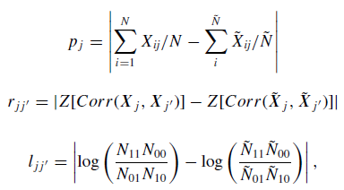
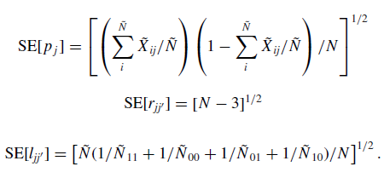

Slide 7
Simulation Study
Data generation: DINA model & A-CDM
Test length: 15 & 30
Q-matrix: Table 1
Q-matrix misspecification: Table 2
Item parameters: Table 4

Slide 8
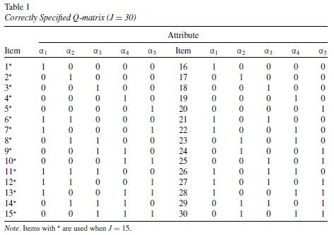

Slide 9
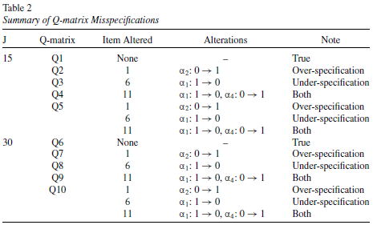

Slide 10
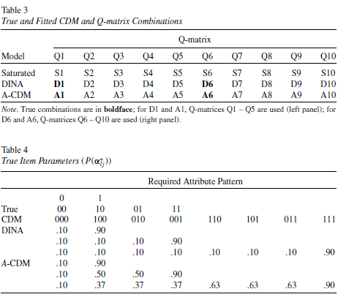

Slide 11
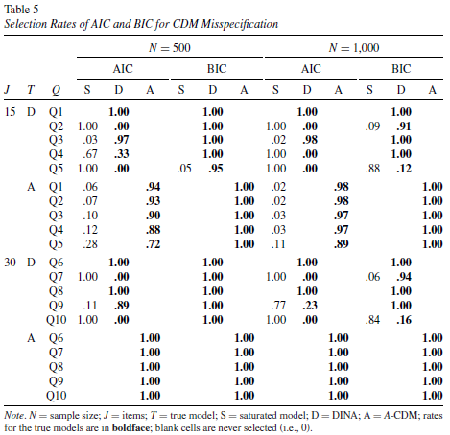

Slide 12
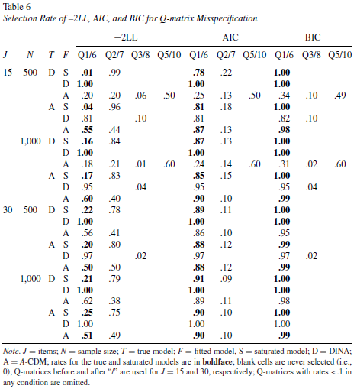

Slide 13
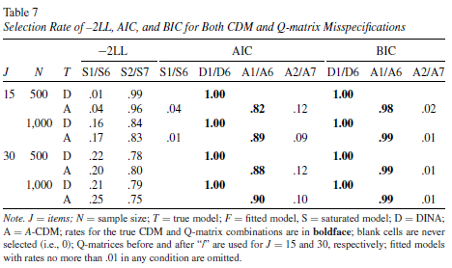

Slide 14
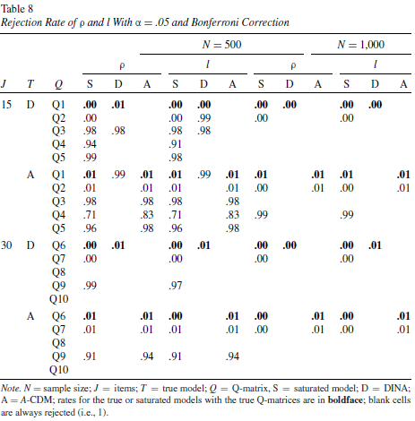

Slide 15
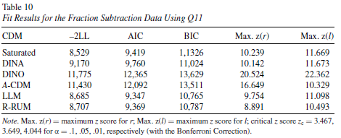
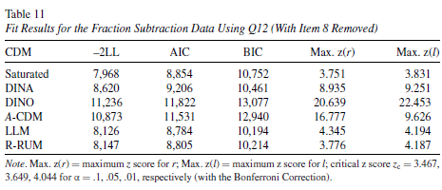

Slide 16
Discussion
The BIC, and to some extent, the AIC, can be useful to detect misspecification of the CDM, the Q-matrix, or both.
For absolute fit evaluation, the r and l had similar performance and were sensitive to different misspecifications in most conditions, although both statistics tended to be conservative.

Slide 17
Future Study
Other misspecification of the Q-matrix
Investigation of fit statistics at the item level
CDMs for polytomous response

