Slide 1
Dealing with Omitted and Not-Reached Items in Competence Tests: Evaluating Approaches Accounting for Missing Responses in Item Response Theory Models
25/11/2013

Slide 2
Missing responses in competence tests
Not-administered items
Omitted items
Not-reached items
B & C are commonly observed in large scale tests.

Slide 3
Dealing with missing responses
Classical approaches
Simply ignore missing responses
Score as incorrect responses
Score as fractional correct
Two-stage procedure
Imputation-based approaches
Disadvantage in IRT models

Slide 4
Model-based approaches for nonignorable missing data mechanism
Latent approach for modeling missing responses due to omitted items
Latent approach for modeling missing responses due to not-reached items

Slide 5
Manifest approach for missing responses
Compute missing indicator
Regress ξ by the manifest variable (latent regression)
Comparison between two approaches

Slide 6
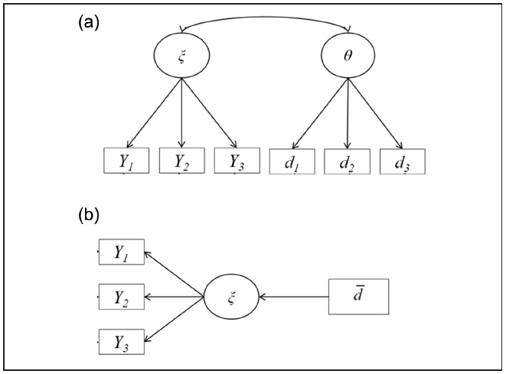

Slide 7
Performance of model-based approaches
Model-based approaches perform better if the corresponding assumptions are met.
Unbiased estimates
Higher reliability
Is the model assumption plausible?
Single latent (or manifest) variable for missing responses

Slide 8
Research questions
Test the appropriateness of the unidimensionality assumption of omission indicator.
Whether the missing responses are ignorable? Or, whether the model-based approaches are needed?
Evaluate the performance of different approaches regarding item and person estimation.

Slide 9
Read data
National Educational Panel Study
Reading (59 items) and mathematics (28 items)
N = 5194
Averaged missing rate (per person):
Omitted item: 5.37% and 5.15%
Not-reached items: 13.46% and 1.32%

Slide 10
Analysis
Five approaches (models)
M1: missing responses as incorrect
M2: two-step procedure
M3: ignoring missing responses
M4: manifest approach
M5: latent approach

Slide 11
Analysis (cont.)
Four kinds of missing responses
Omitted items only
Not-reached items only
Composite across both
Dealing with both separately (Figure 2)
Two competence domains

Slide 12
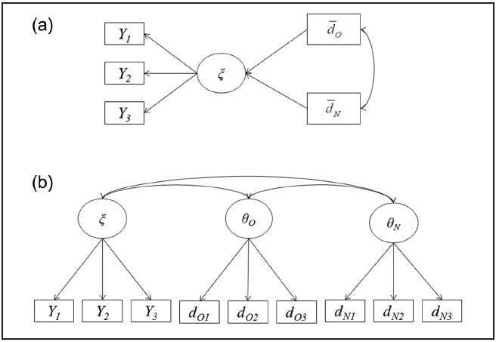

Slide 13
Results
Dimensionality of the omission indicators
Acceptable WMNSQ
Point-biserial correlation of the occurrence of missing responses on an item and the overall missing tendency
Amount of ignorability
A long story…
Five conclusions

Slide 14
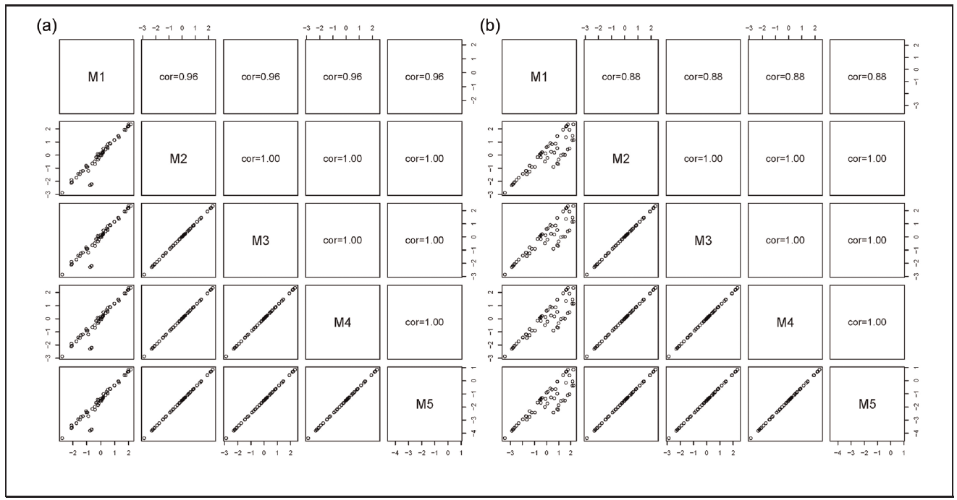

Slide 15
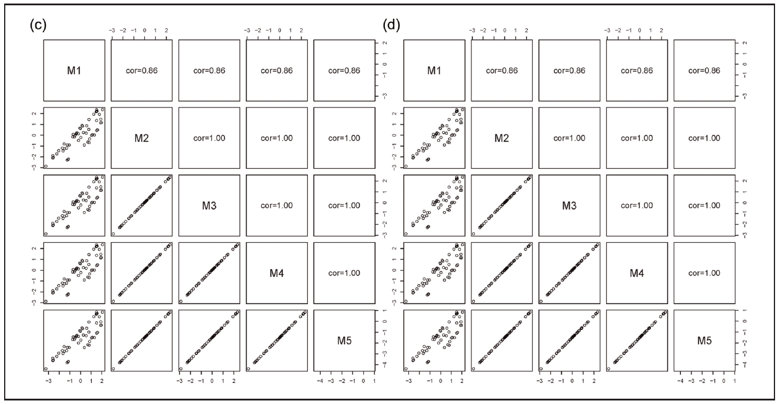
Item parameter estimates

Slide 16
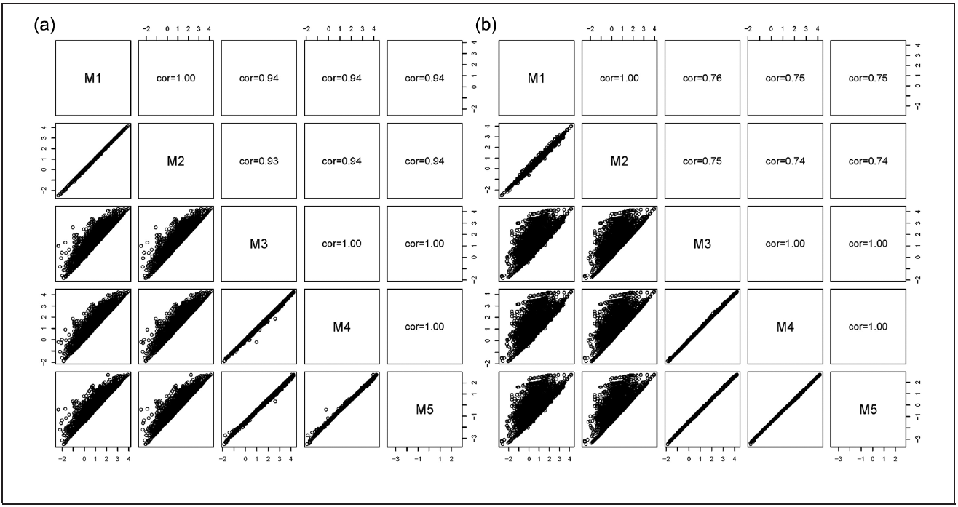
Person parameter estimates

Slide 17
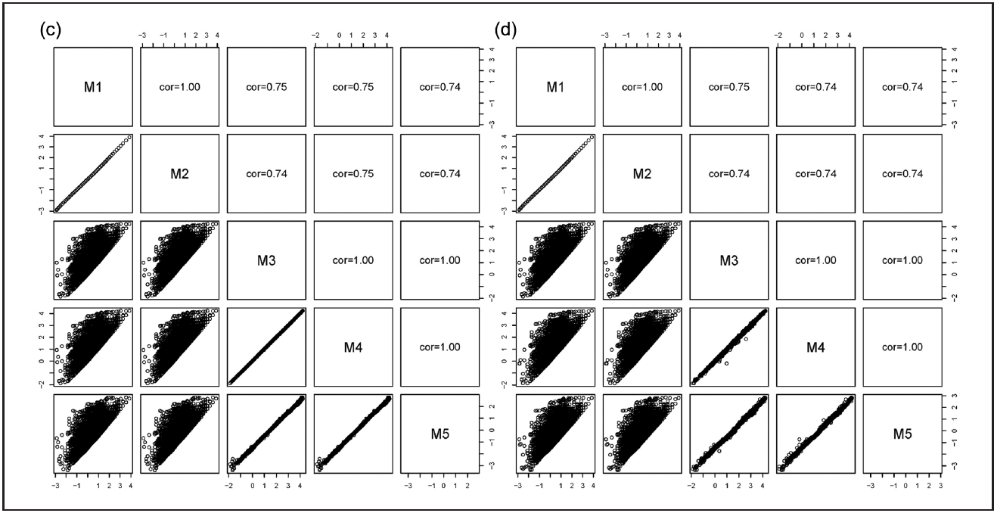

Slide 18
Complete case simulation
True model: Figure 2b
One for omission
Mean omission rate per item: 3.7%
Two for time limits
Positive or negative correlation between latent ability and missing propensity
Mean percentage of not-reached items per persons: 13.4% and 12.5%
Two simulation datasets were produced.

Slide 19
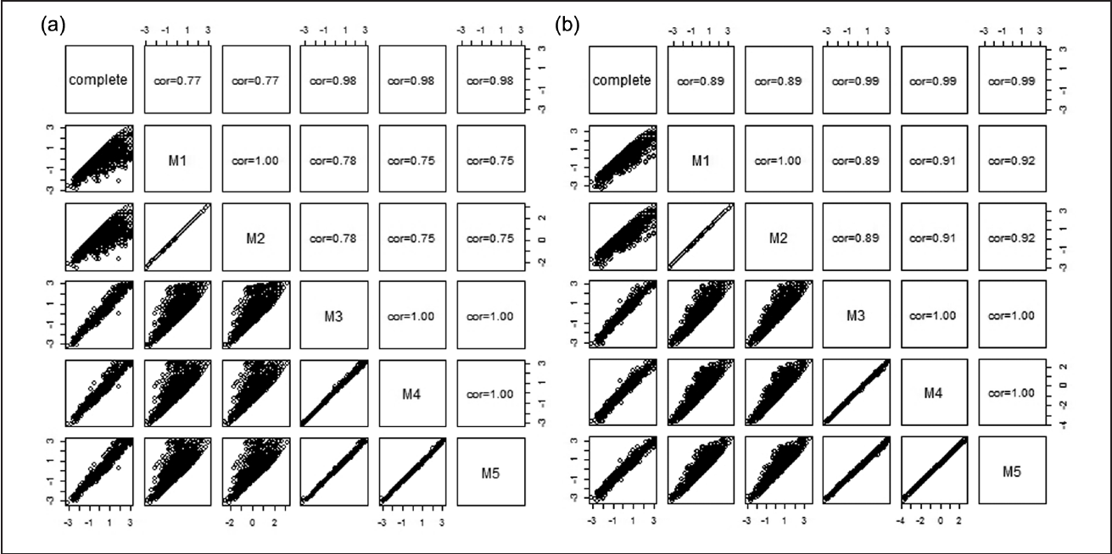
Results

Slide 20
Discussion
Model-based approaches successfully draw on nonignorability of the missing responses.
It was found the missing propensity was not needed to model item responses. (why not?)
The findings are limited to low-stakes tests.
Is there a general missing propensity across competence domain and time?

