Slide 1
Using a Theorem by Andersen and the Dichotomous Rasch Model to Assess the Presence of Random Guessing in Multiple Choice Items
David Andrich
Ida Marais
Stephen Humphry
The University of Western Australia

Slide 2
Introduction
Random Guessing
A function of the proficiency of a person relative to the difficulty of an item(Waller, 1973, 1976, 1989)
Not a property of an item per se
Why Rasch?
Independent
Simple in adaptive assessment

Slide 3
Procedures
First Analysis: Full sample
Second Analysis (Tailored Analysis): Subsample which treat some responses as missing; Think about it in CAT environment
Third Analysis (Anchored Analysis)

Slide 4
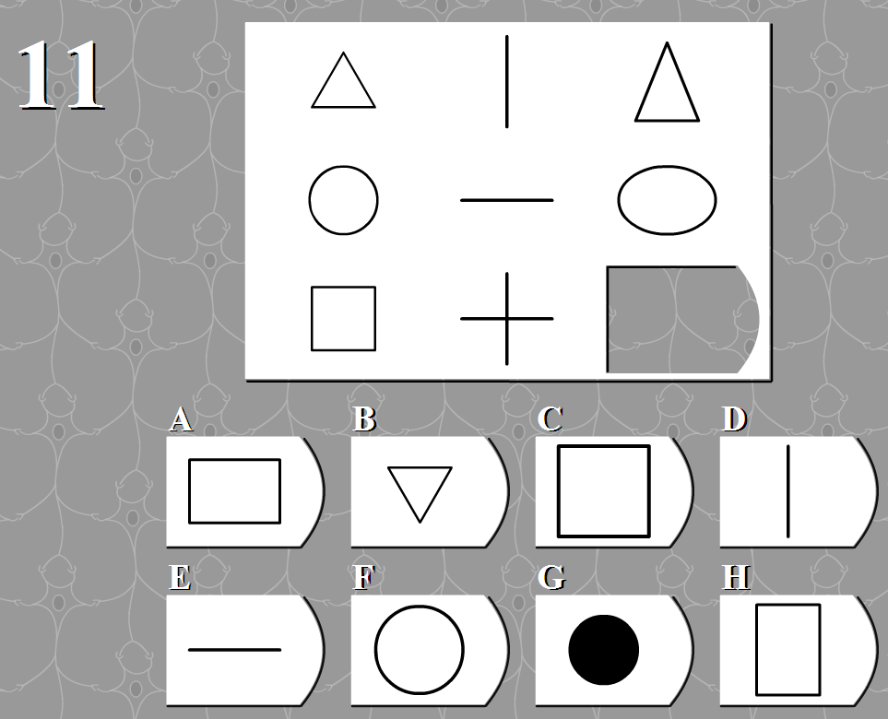
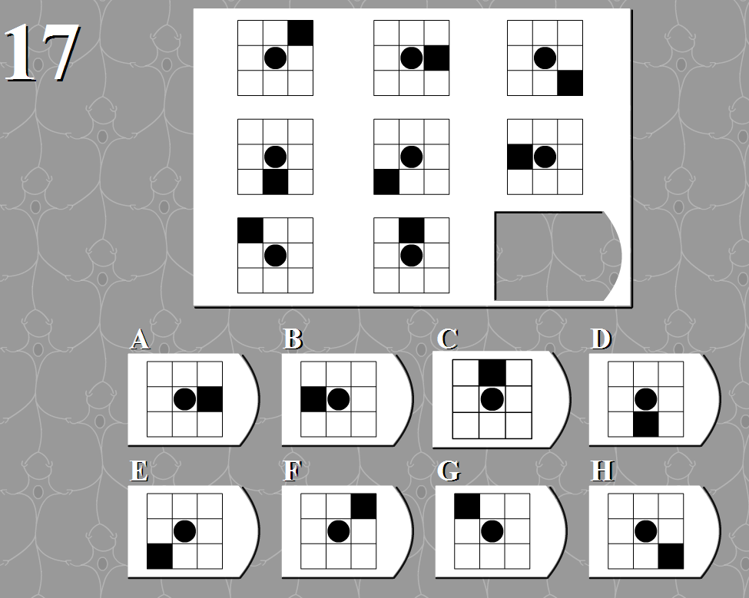
Data
The Advanced Raven’s Progressive Matrices (ARPM; Raven, 1940)
35 items
6 to 8 alternatives for each item
Source: http://www.iqtest.dk/main.swf

Slide 5
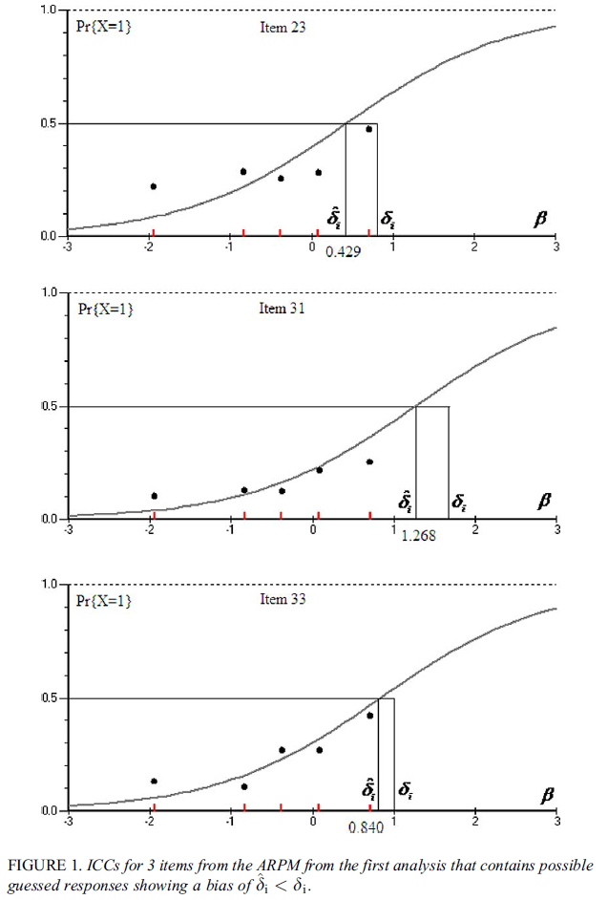
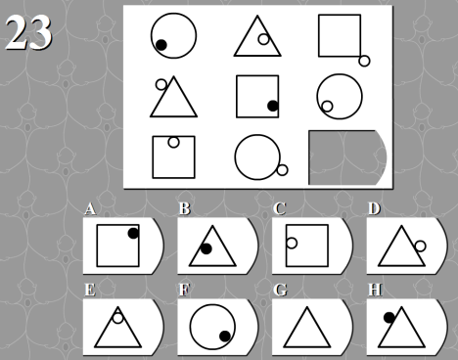
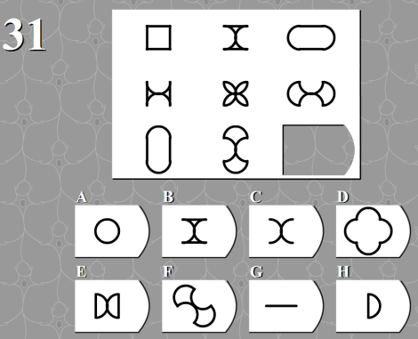
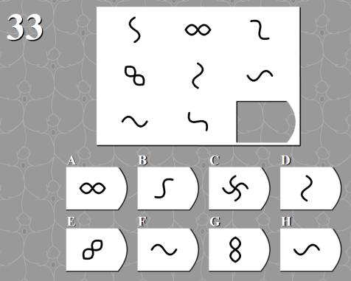
Random Guessing in APRM

Slide 6
Random Guessing and Rasch Model
Rasch Model
Guessing -> underestimate of item difficulty
Aim: Get more accurate item difficulty estimates.

Slide 7
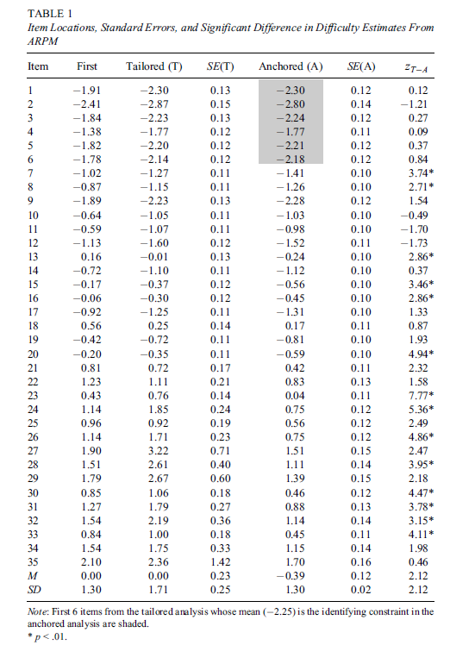
The author proposed that the Tailored analysis yields more accurate item estimates since it eliminated the response which had guessing.

Slide 8
Simulation Study
Simulation data was generated based on the APRM empirical data.
Model for data generation
where y is any positive integer.
In the case of APRM and simulated data, c_{i}=1/7, y was fixed to 15.

Slide 9
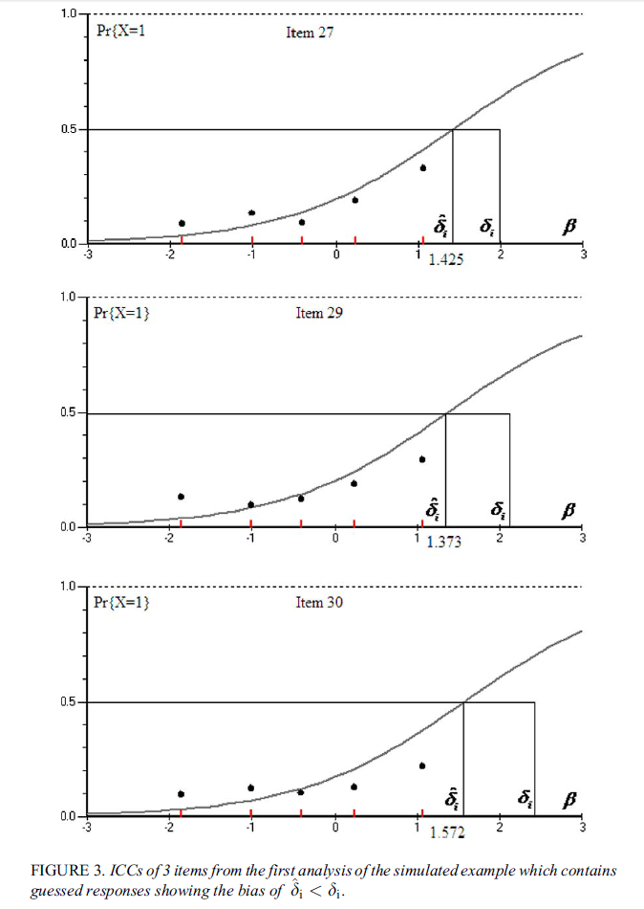
First Analysis of Simulated Data
This figure is very similar to Figure 1 and shows that the presence of guessing yields less difficulty than generated values.

Slide 10
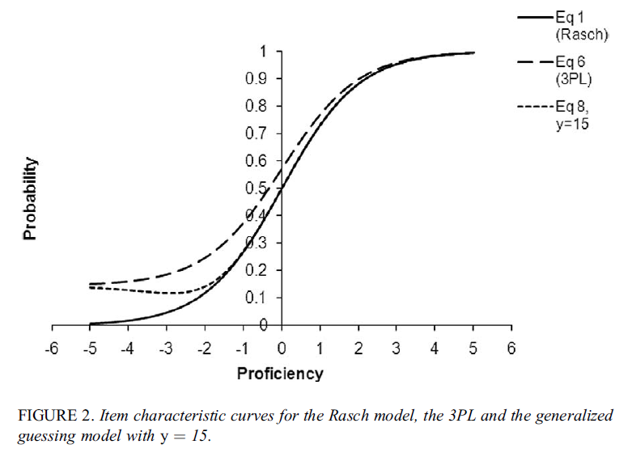
0.27 (set 0.3 as cut value)

Slide 11
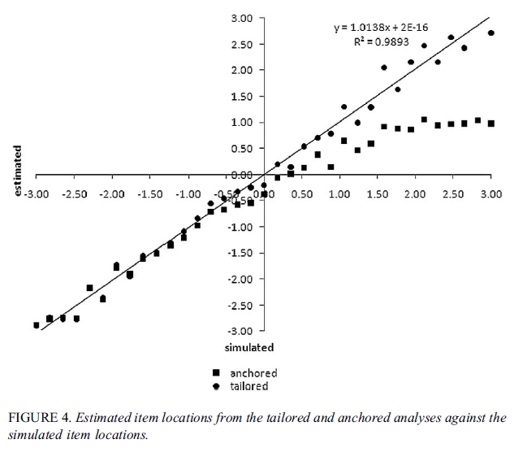
Tailored Analysis of Simulated Data
The estimates from the tailored analysis very close to simulated values.
When the items become difficulty, more dispersion.
The estimates from the anchor analysis show systematic deviation.

Slide 12
Hypothesis Testing of item difficulty changes
Z statistics
Andersen’s Theorem

Slide 13
Anchor Analysis of Simulation Data
Fixed the mean of six easiest items as the mean of them in tailored analysis.
Full sample with all response (with the presence of random guessing)

Slide 14
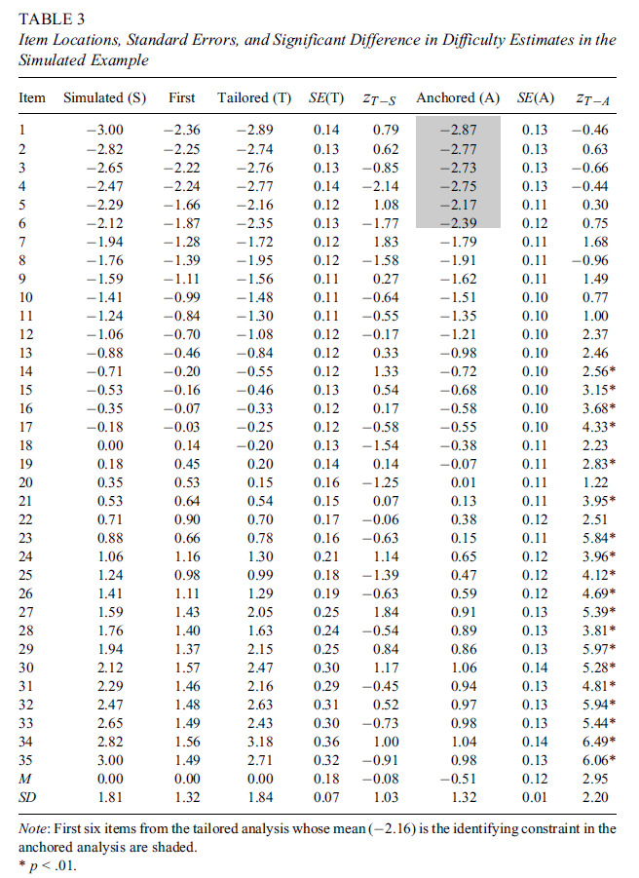
The estimates from Tailored is more accurate.
By Z_{T-S}, no items showed significant difference.
By Z_{T-A}, 19 of 23 relatively harder items showed significant difference.
Questions:
The estimates from first analysis is more like shrink rather than underestimated
The estimates are out of order in all three kind of analysis

Slide 15
Summary
A statistical test was constructed to examine whether item estimates are affected by guessing using Andersen’s theorem.
The tailored analysis recovered the simulation locations.

Slide 16
Discussion, and Further Research
Impact of guessing on person estimates
How to decide anchor items
Test of fit
The relation of discrimination and guessing

