Slide 1
Playing the y-model
XU Kun
24 Nov 2011

Slide 2
Outline
Revisit the performance of tailored analysis procedure (Andrich, Marais & Humphry, 2011)
Impact of guessing on person estimates
Fit Statistics before and after controlling for guessing

Slide 3
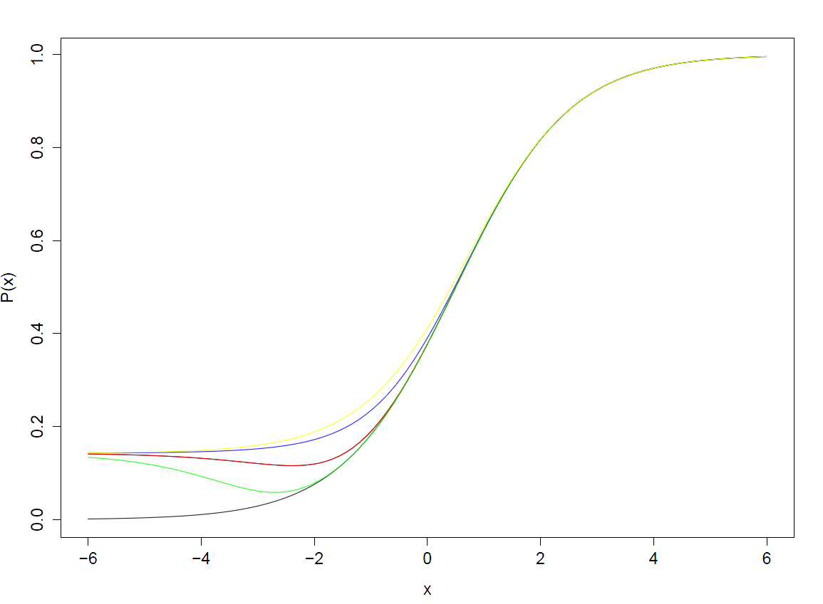

Slide 4
Data Generation
500 students theta ~ N(-0.75, 1.2²)
35 items b ~ U(-3.0, 3.0)
c fixed to 1/7
y fixed to 15
100 replications

Slide 5
Analysis
First analysis by Winsteps
Export the item difficulty and student ability estimates
Calculate the probability of each student on each item
Prepare the data set for Tailored analysis
Tailored analysis by Winsteps

Slide 6
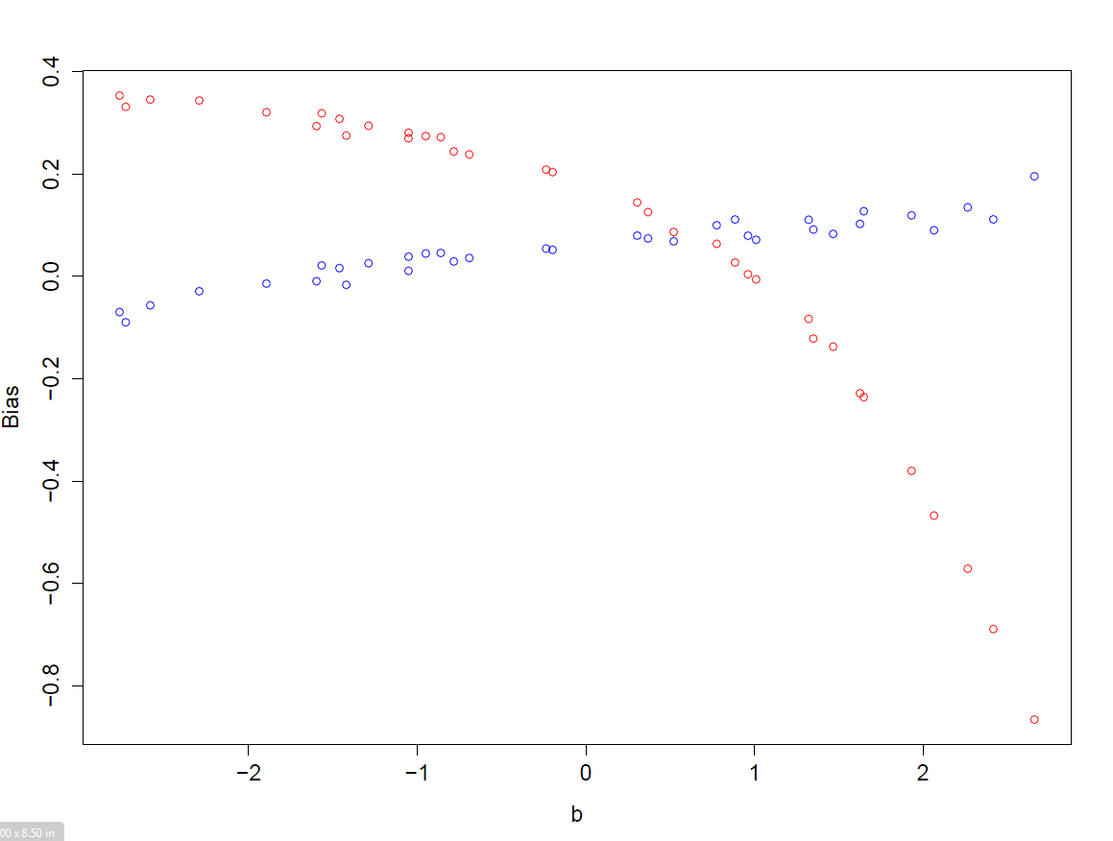
Bias of Item Difficulty

Slide 7
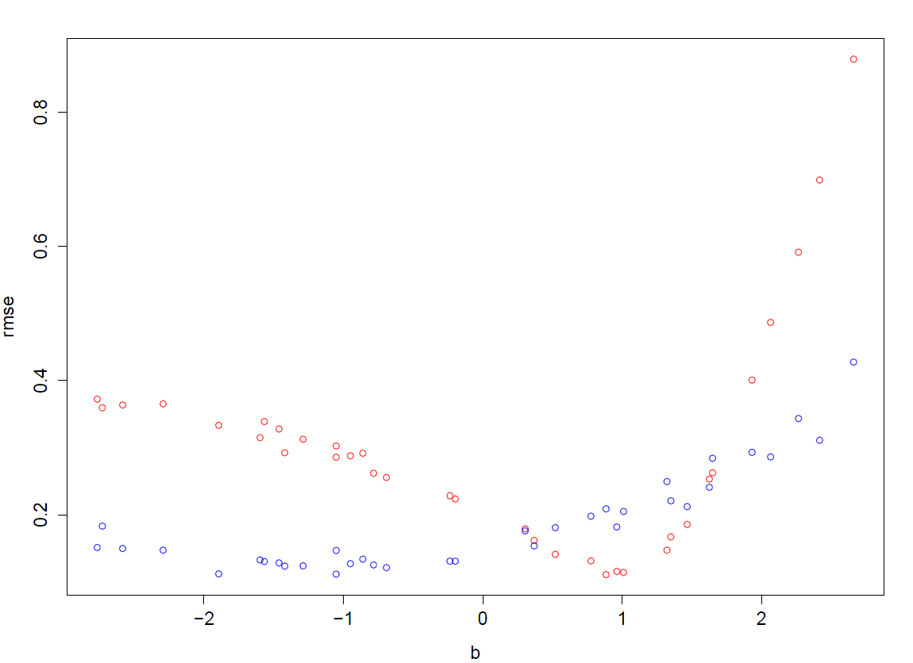
RMSE of Item Difficulty

Slide 8
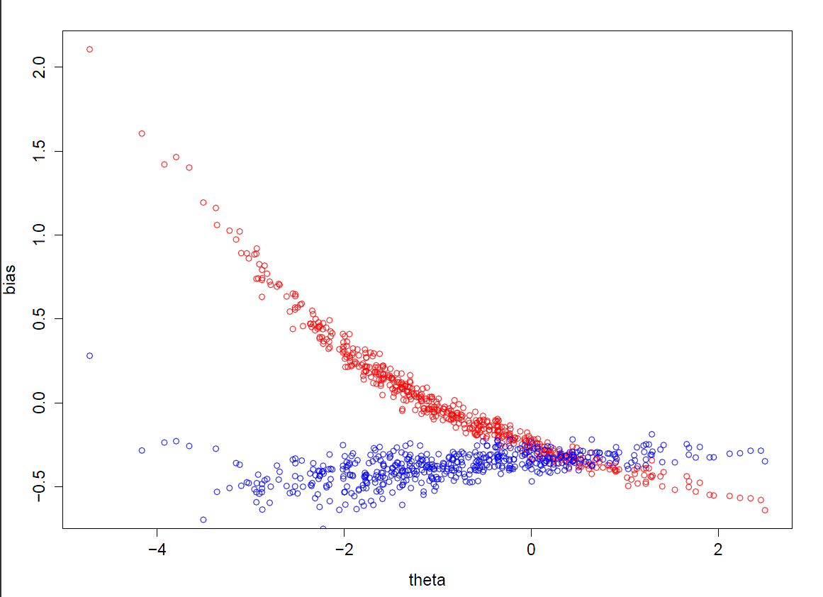
Bias of Student Ability

Slide 9
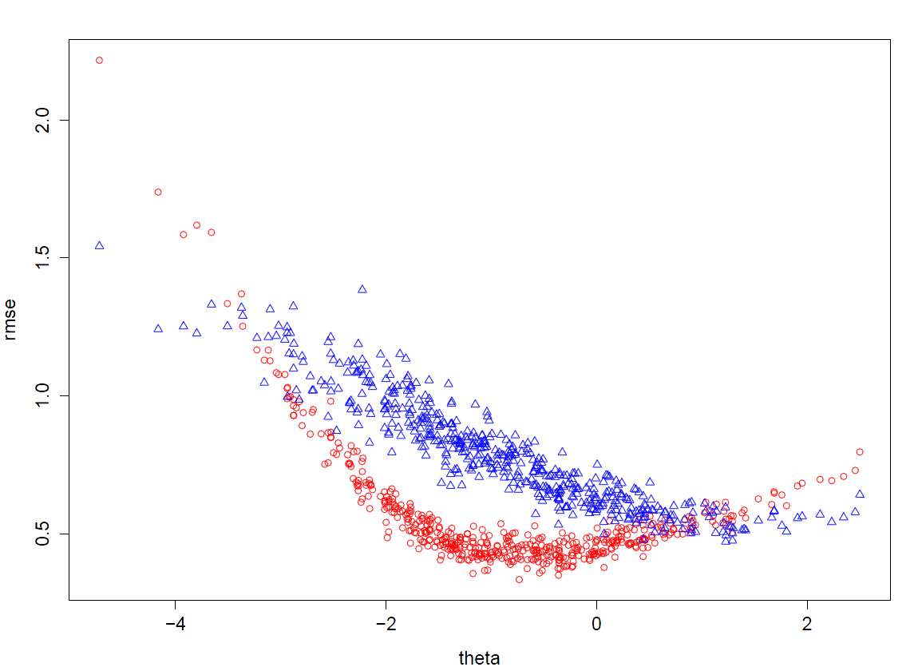
RMSE of Student Ability

Slide 10
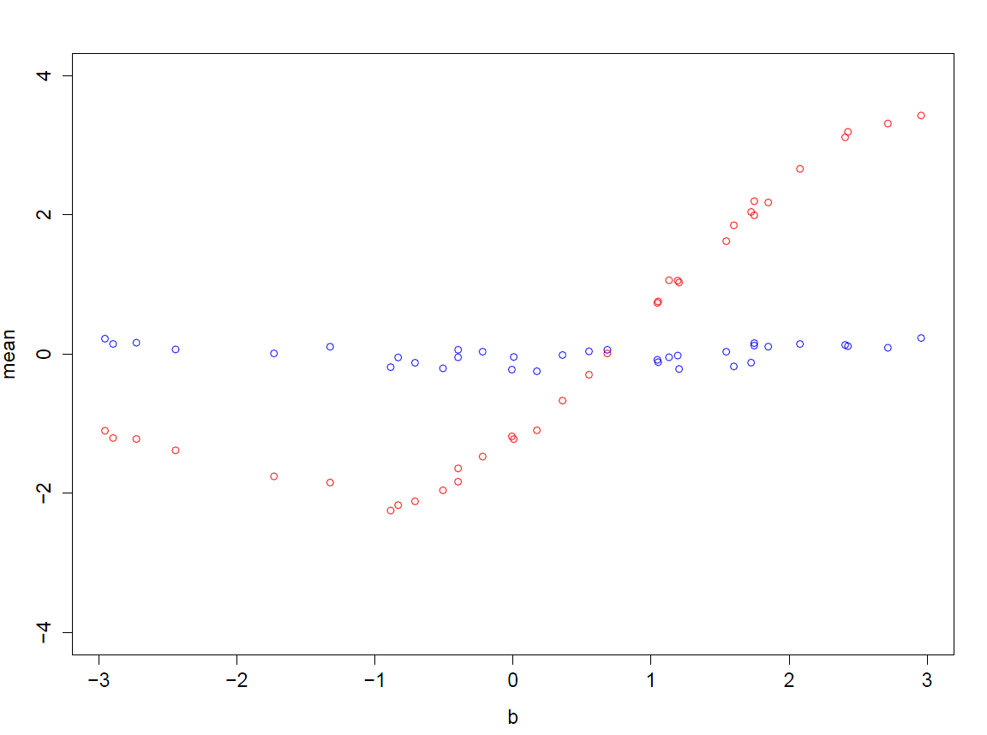
Outfit Standardized t of Item

Slide 11
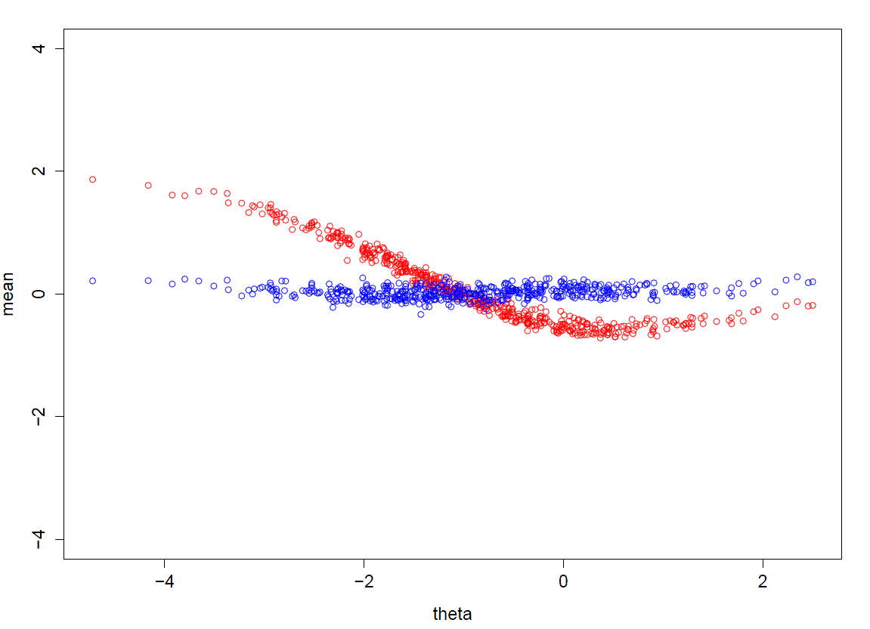
Outfit Standardized t of Student

