Slide 1
Investigating Faking Using a Multilevel Logistic Regression Approach to Measuring Person Fit

Slide 2
Multilevel logistic regression (MLR)
This study adopted the MLR approach (Reise, 2000) to assess person fit (faking?).
We are not the first to suggest that person fit indices might indicate faking (p. 302).
Modeling a person slope in the 2PLM, as well as the idea I presented last year.
A steeper slope indicates a better person fit.

Slide 3
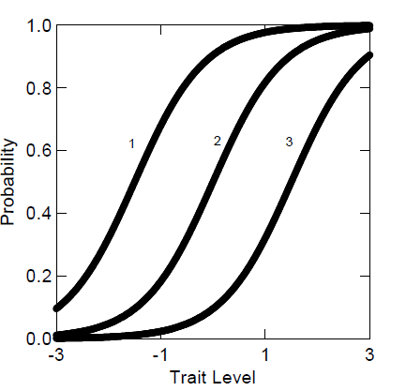
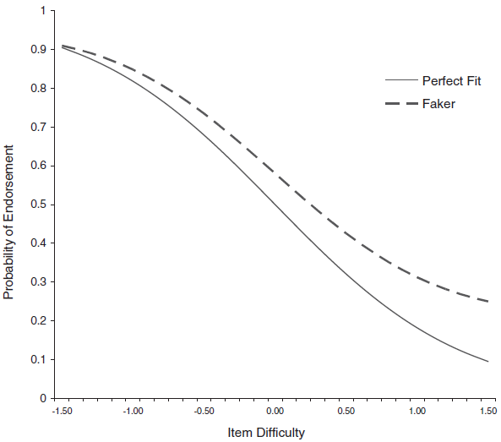
ICC Versus PRC

Slide 4
MLR and Person Fit
Empirical Bayes estimates of slopes
summarize the overall relationship between the probability of item endorsement and item difficulty for each individual.

Slide 5
MLR Person Fit and Faking
Two paradigms: Changing items or changing persons?
PRCs are similar to random coefficient growth curves.

Slide 6
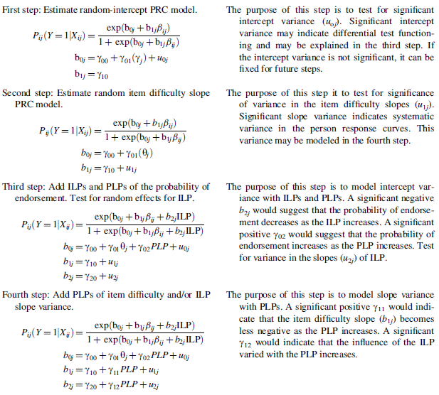

Slide 7
MLR and Traditional IRT Methods of Investigating Faking
MLR and lz
a correlation of −.65 between lz and the MLR-based EB slopes (Reise, 2000).
Item-level and person-level predictors can be incorporated into the PRCs.
The MLR approach provides significance tests of slope variance to identify the presence of systematic variance in person fit.
MLR and DIF and DTF
u_{0j}

Slide 8
Example 1
Mplus for data generation (according to MLR)
BILOG-MG for IRT analysis
Modfit for model checking
HLM for MLR
Step 1: the intercept did not significantly vary
Step 2: a significant variance in slope
Step 3: motivation to fake was positively related to the item difficulty slope
Two hierarchical regression analysis

Slide 9
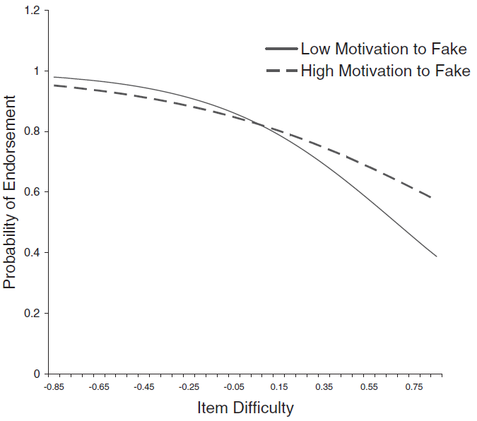

Slide 10
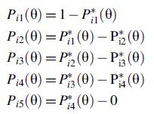
Graded Response Model
The GRM treats the ordered response options as a series of dichotomous 2PL models.
It is helpful to determine the point on the scale where faking occurs.

Slide 11
Example 2
BIG-5 items from the IPIP
DV: agreeableness and extraversion
Some are negatively worded items
Four response options were created
Two expectation:
Conscientiousness versus PRC slope
Neuroticism versus PRC slope
Multilog for IRT analysis
Notes:
情緒穩定性﹝Neuroticism﹞
外向性﹝Extraversion﹞
開放性﹝Openness to Experience﹞
和善性﹝Agreeableness﹞
嚴謹自律性﹝Conscientiousness﹞

Slide 12
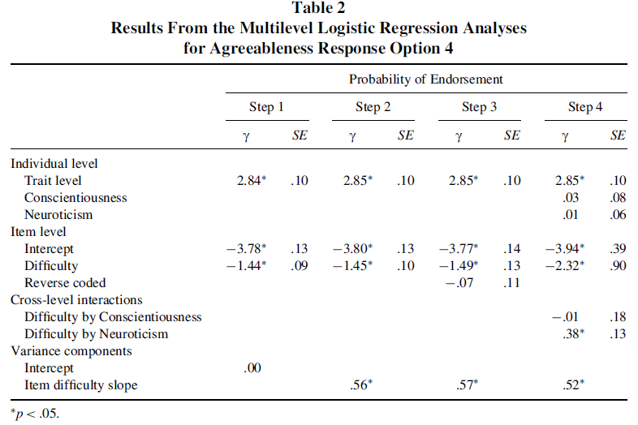

Slide 13
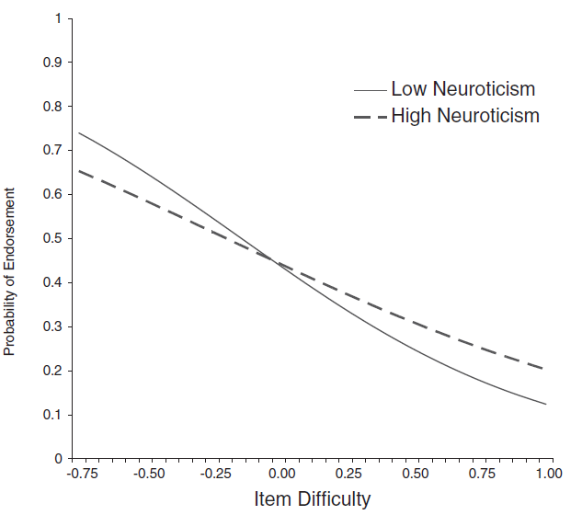

Slide 14
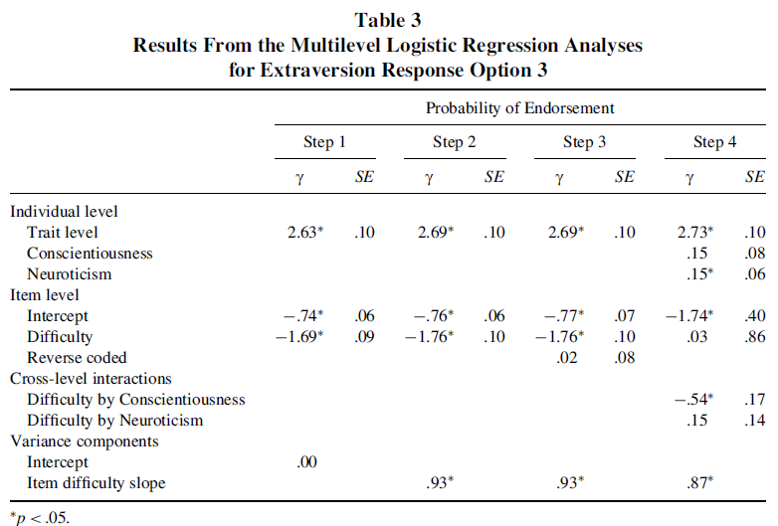

Slide 15
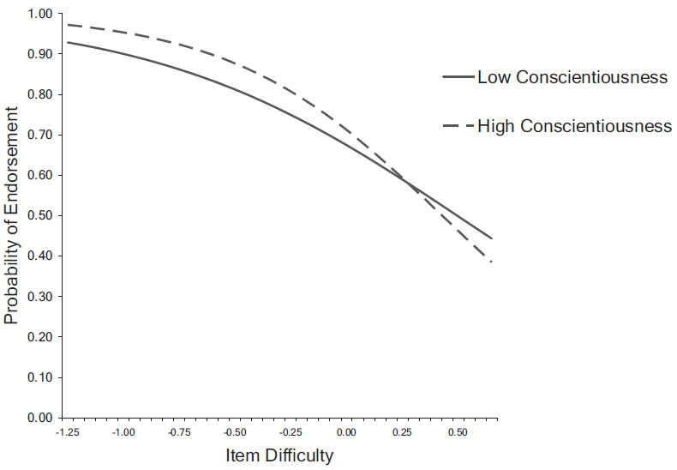

Slide 16
Example 2 Summary
For agreeableness
Negatively worded items
Neuroticism
For extraversion
DTF (option 1)
Conscientiousness

Slide 17
Conclusion
Three major advantages of the MLR
A continuous variable for faking
A general framework for testing hypotheses about faking
A tool for polytomous data
Limitations
A lack of person fit = faking?
How about guessing?
The distribution of EB slopes
What if the IRT model cannot fit data well?

