Slide 1
Calibration of Response Data Using MIRT Models with Simple and Mixed Structures
Jinming Zhang
University of Illinois at Urbana-Champaign

Slide 2
Multidimensionality

Slide 3
Structure
Simple structure test (SST)
items belong to one and only one dimension
Mixed structure test (MST)
items belong to one or more dimensions
Approximate simple structure test (ASST)
most of the items belong to one and only one dimension with a little amount of items cross more than one dimensions

Slide 4
Data Analysis
Unidimensional approach
(consecutive unidimensional approach)
calibrate each subtest separately
then calculate the correlations
Unidimensional approximation approach
(unidimensional approach)
treat the whole test as unidimensional
Multidimensional approach
take into account the structure/collateral information
generate correlation/covariance as by-product

Slide 5
M3PL
It is a compensatory model.
M3PL for multiple-choice items and M2PL for dichotomously scored constructed-response item.

Slide 6
Simple Structure
When and in other dimension, the M3PL model become two separate U3PL model.

Slide 7
Item Parameter Estimation
JMLE
abilities are treated as fixed unknown parameters
theoretically, same parameter estimates for unidimensional and multidimensional approach
Estimates are not consistent
MMLE
abilities are treated as random variable with a prior distribution
involving the correlation matrix
Did not consistent for unidimensional and multidimensional approach

Slide 8
Simulation Study with SS
Purpose: The accuracy of item parameter estimates obtained from unidimensional and multidimensional approaches in MMLE method.
Three factors:
The number of items: 30, 46 or 62
Sample size: 500, 1000, 2000, 3000, 4000, 5000
The correlation coefficient: 0, .5 or .8
Total 54 combinations which implemented by ASSEST with 100 replications.

Slide 9
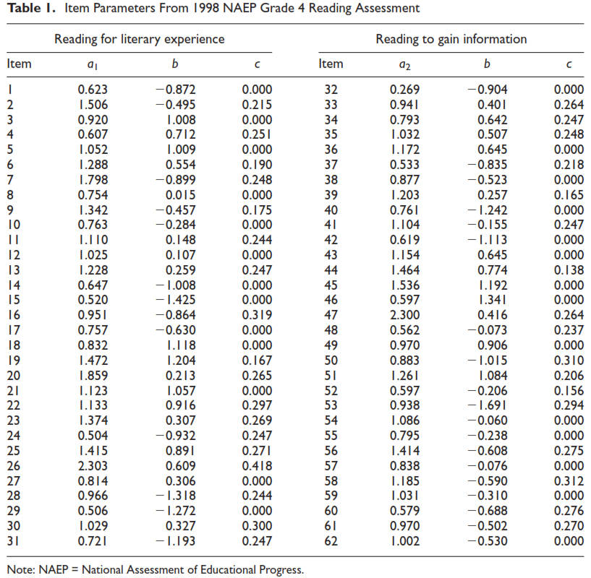

Slide 10
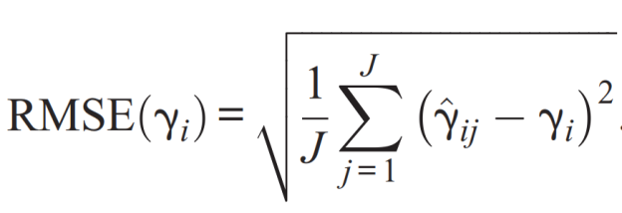
Evaluation
RMSE for each item parameter and correlations
RMSE for item response function (IRF)
Percentage of counts for the superior approach

Slide 11
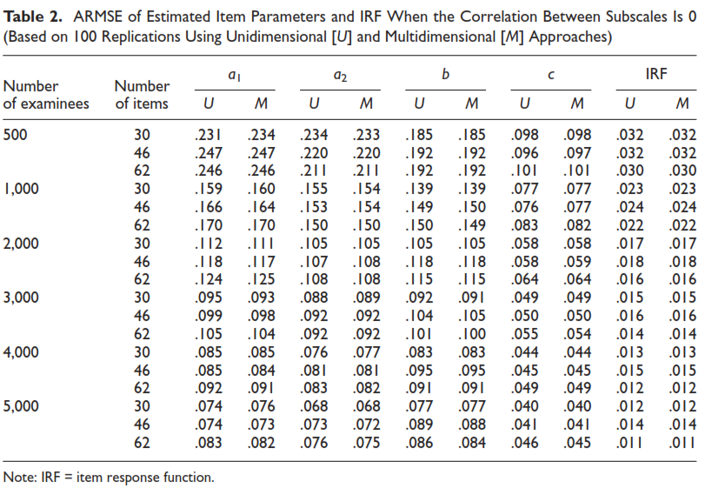

Slide 12
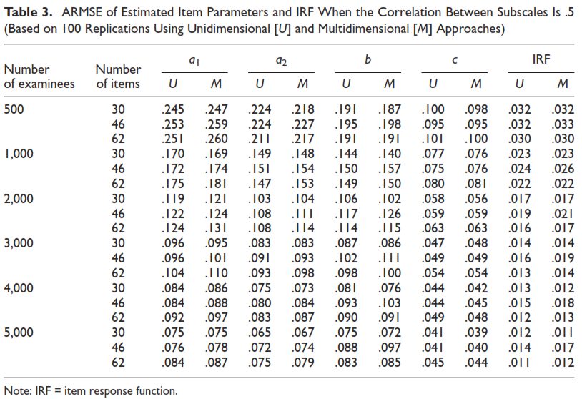

Slide 13
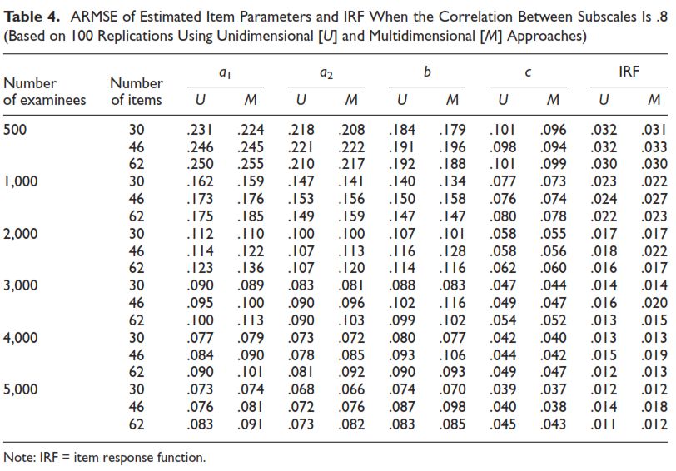

Slide 14
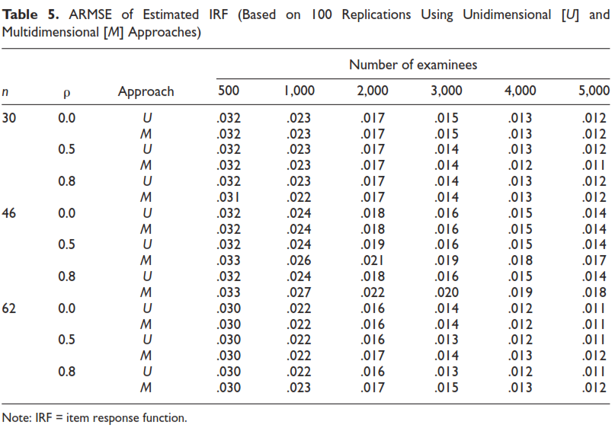

Slide 15
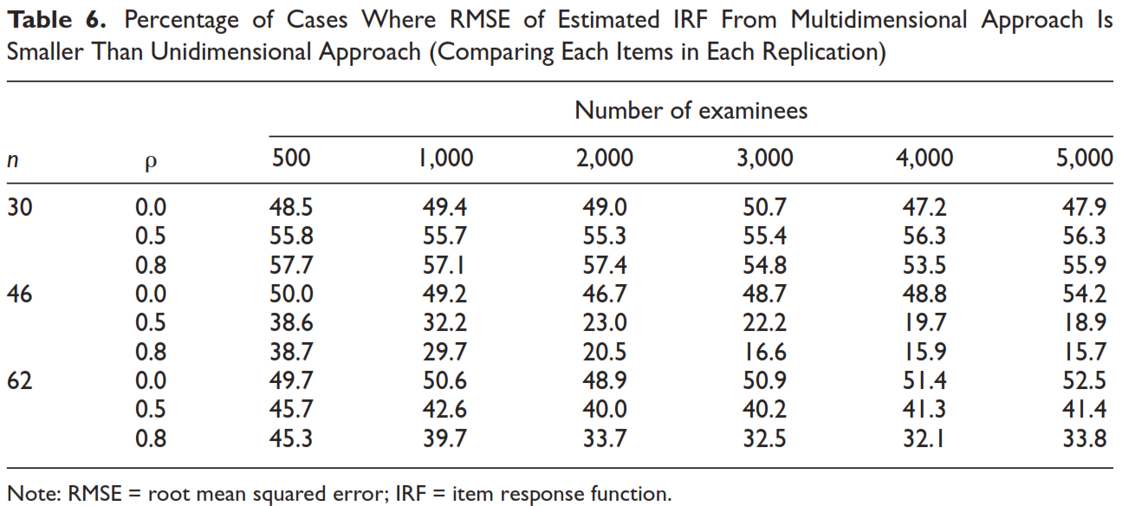

Slide 16
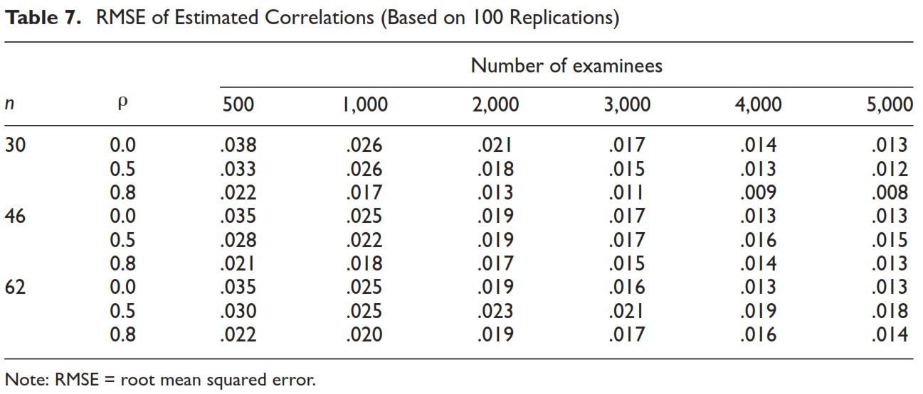

Slide 17
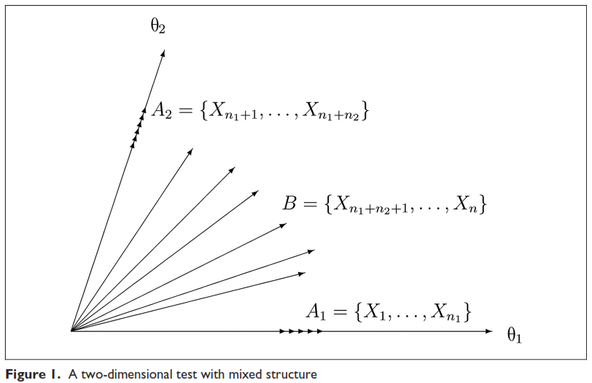
Mixed Structure

Slide 18
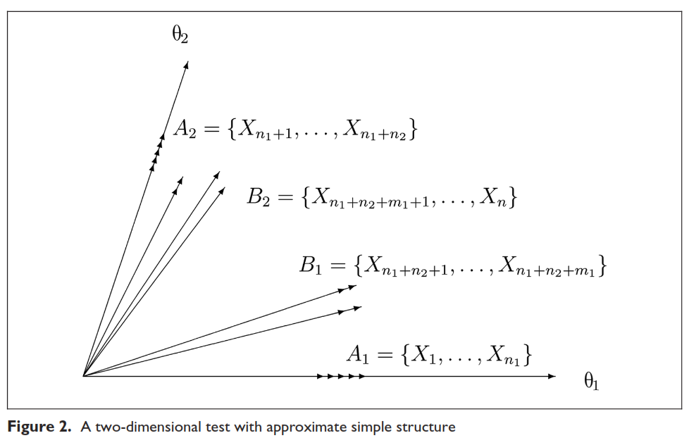
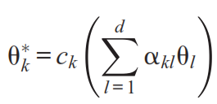
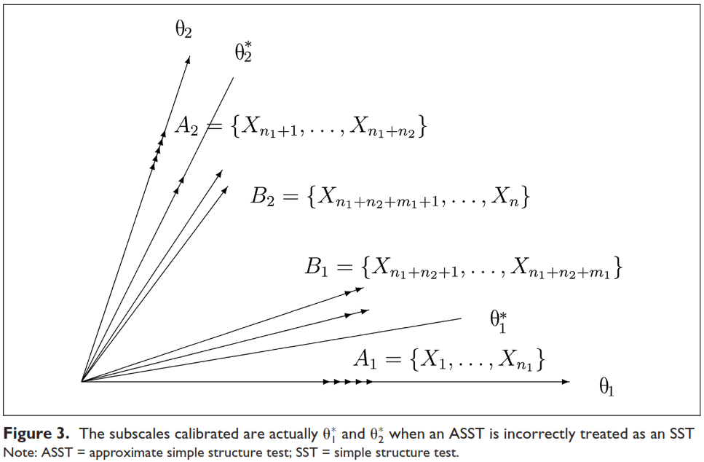
Approximate simple structure
Reference composite:
Correlation coefficients between reference composite:

Slide 19
Simulation Study with MS
Purpose: The consequences of the violation of simple structure.
Three factors:
The number of items: 30
Sample size: 1000, 3000, or 5000
The correlation coefficient:.8
Total 3 combinations which implemented by ASSEST with 100 replications.

Slide 20
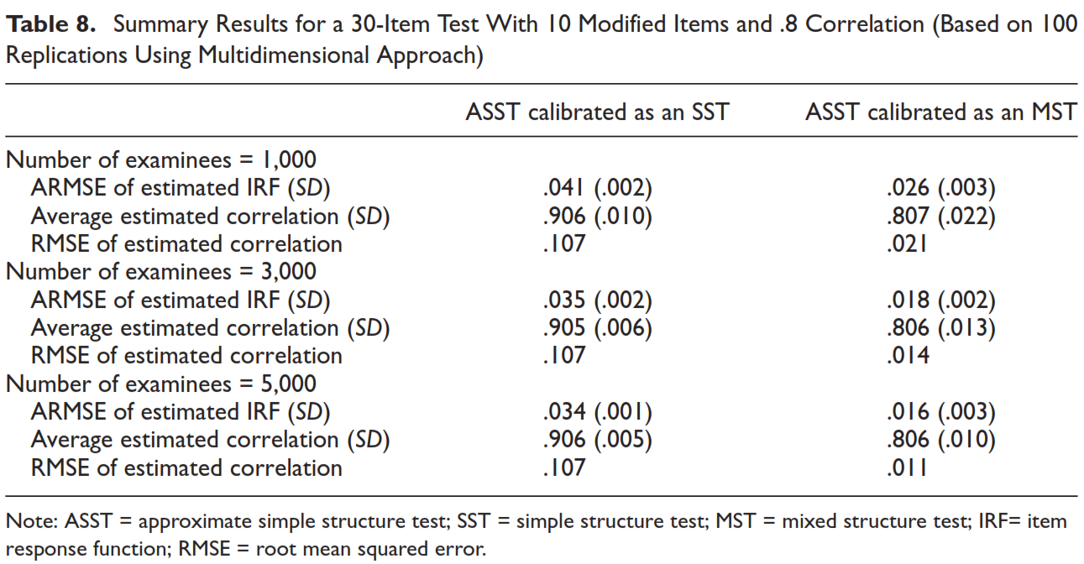

Slide 21
Conclusion and Discussion
For SST, when MMLE is applied, when the number of items is mall, multidimensional approach is superior; otherwise, unidimensional approach is superior.
For MT (ASST), the correlation will be overestimated while the items were mis-specified.

